Slide 1
Blockchain-Based Supply Chain Transparency for Agricultural Produce
Group No: 016
Group Name: AgriChain
Project Guide: Prof. Md Tauseef
Group Members
J A Dharma Sudeep (R20EP072)
Chandan B Krishna (R22EP008)
Chandu M (R22EP009)

Slide 2
Contents
Abstract
Introduction
Literature Survey
Problem Definition/ Objective
Methodology
Expected Applications
SDG Mapping
Frontend Development DEMO
References

Slide 3
Abstract
Aim: Use blockchain to ensure end-to-end traceability, origin tracking, and pricing fairness for agricultural produce.
Approach: Record each event (“harvest → process → ship → receive → sell”) on a tamper-proof distributed ledger.
Key Features: Smart contracts for automated rules (e.g., payment on delivery), QR codes for consumer-facing provenance.
Significance: Reduces fraud, speeds recalls, increases trust, and supports equitable value distribution.
Outcome: Prototype platform demonstrating rapid traceability, improved transparency, and fair pricing support.

Slide 4
Introduction
Current Pain Points: Fragmented records, limited visibility, slow recalls, information asymmetry, and farmer exploitation.
Why Blockchain: Shared ledger, immutability, consensus validation, auditable history, and multi-party access.
Stakeholders: Farmers, cooperatives, certifiers, processors, logistics providers, distributors, retailers, consumers, regulators.
Impact Goals: Faster trace-backs, authenticated origin/quality, transparent pricing, and higher consumer confidence.

Slide 5
Literature Survey
Academic Trends: Blockchain + IoT for traceability; smart contracts for automated compliance and payment; permissioned networks for privacy/performance.
Frameworks Compared: Ethereum (public, rich tooling) vs. Hyperledger Fabric (permissioned, high throughput, fine-grained access).
Industry Pilots: Large retailers and agri-platforms show faster trace-backs, QR-based consumer transparency, and operational efficiencies.
Gaps Identified: Data veracity at entry (“garbage-in”), onboarding smallholders, scalability, interoperability, and regulatory alignment.

Slide 6
Problem Definition/ Objective
Problem Statement:
Lack of trusted, end-to-end transparency in agri supply chains leads to food safety risks, fraud, inefficiencies, and unfair farmer compensation.
Objectives:
End-to-End Traceability: Immutable chain of custody for each batch/lot.
Pricing Fairness: Visibility of price transitions; smart-contract payments to reduce delays and hidden markups.
Data Integrity & Safety: Cryptographic assurance; rapid isolation of affected batches during incidents.
Inclusion: Simple mobile/web interfaces and QR codes to onboard smallholders and downstream actors.

Slide 7
Methodology
Architecture:
Consortium, permissioned blockchain connecting all stakeholders; on-chain state for batches/lots; off-chain storage (e.g., docs, certificates) referenced by hashes.
Smart Contracts & Data Model:
Entities: Farm, Batch, Transfer, QualityCheck, PriceEvent.
Functions: createBatch, recordTransfer, recordQuality, setPrice, releasePayment, flagRecall.
QR & IoT Integration:
Unique QR per batch; scans append events to ledger.
Optional IoT (temperature/humidity) feeds via middleware for automatic logging and alerting.

Slide 8
Methodology
Phased Execution:
Design & Simulation → 2) Prototype (contracts, APIs, UI) → 3) Integration & Testing → 4) Pilot & Evaluation.
Risk Management:
Adoption (training, UX in local language), data veracity (sensor cross-checks/audits), performance (batching, permissioned consensus), security (authN/authZ, encryption).

Slide 9
EXPECTED Applications
Food Safety & Recalls: Rapid, surgical recalls; reduced waste and liability.
Consumer Transparency: QR-based provenance (origin, dates, certifications) to build trust and brand value.
Fair Farmer Payments: Direct or rules-based settlements on delivery; clearer value distribution.
Anti-Fraud & Compliance: Harder to mislabel/adulterate; auditable logs for regulators and certifiers.
Process Optimization: Ledger analytics for choke-point detection, SLA monitoring, and quality improvements.

Slide 10
SDG MAPPING
SDG 9 (Industry, Innovation & Infrastructure): Digitizes agricultural infrastructure with resilient, interoperable systems.
SDG 12 (Responsible Consumption & Production): Cuts waste via precise recalls; enables informed consumer choices.
SDG 8 (Decent Work & Economic Growth): Faster, fairer payments and market access for smallholders; inclusive growth.
Co-Benefits: Supports SDG 1/2 through improved livelihoods and safer food ecosystems.

Slide 11
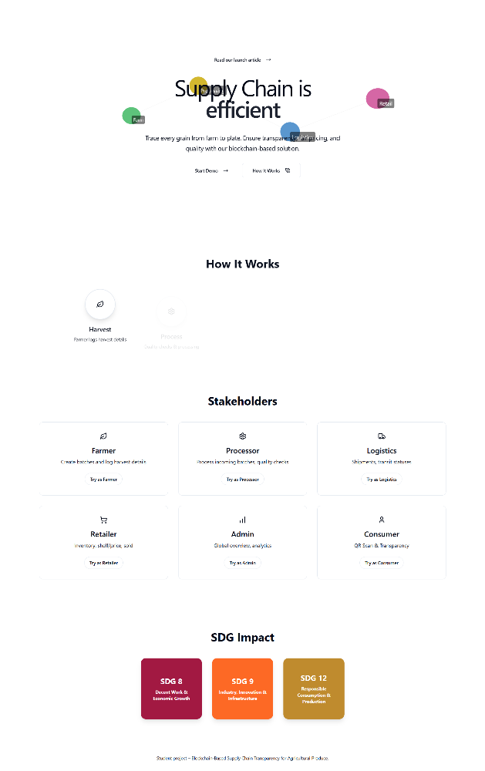
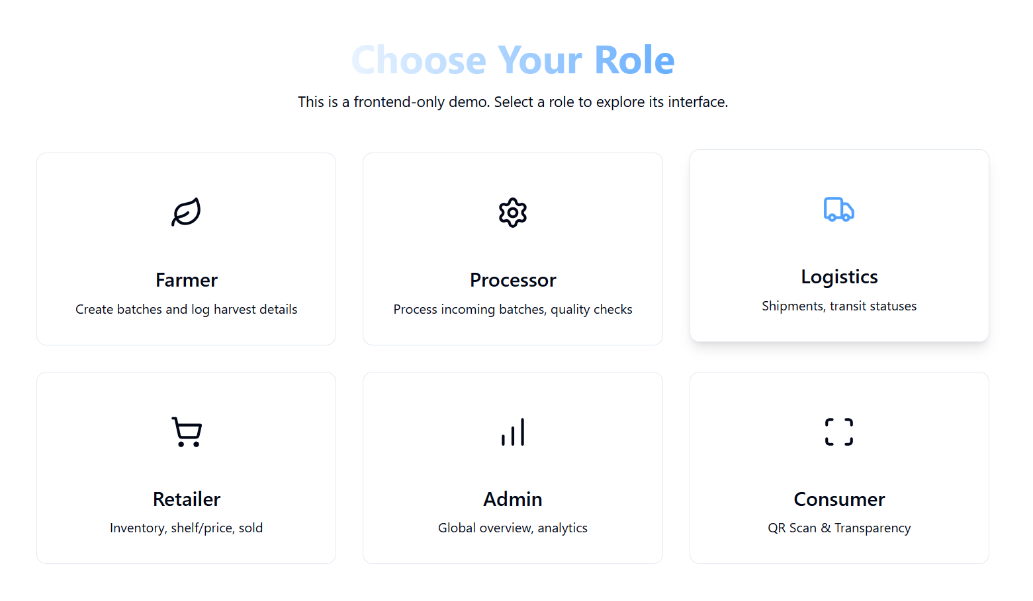
FRONTEND DEVELOPMENT:
2. Role page
1. Home page

Slide 12
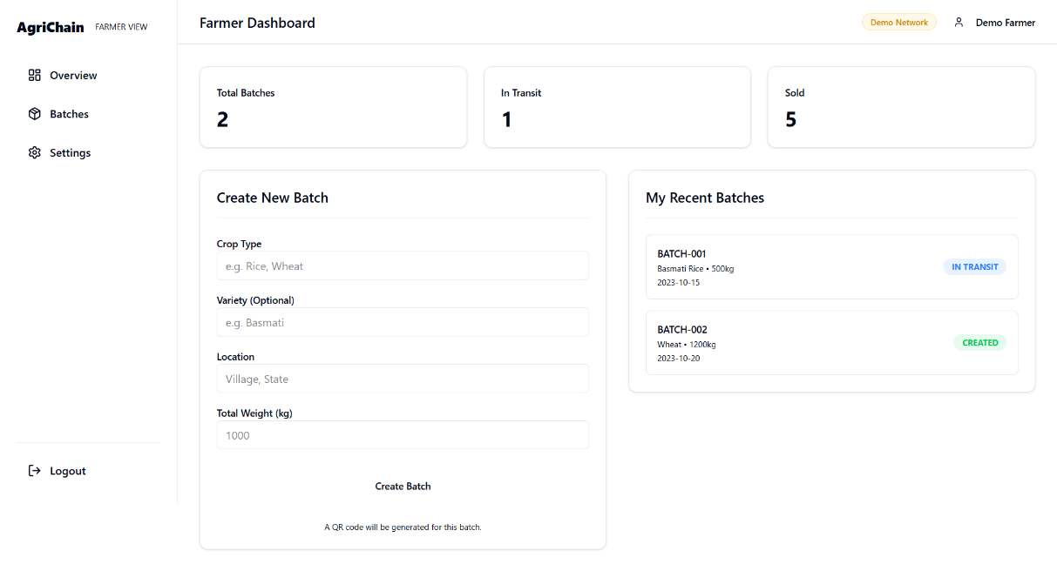
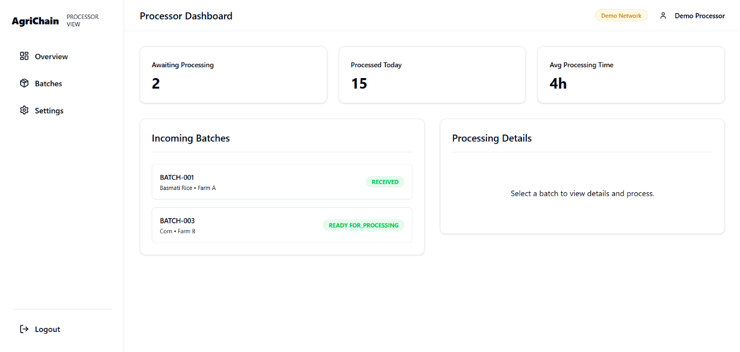
FRONTEND DEVELOPMENT
3.Farmer Dashboard
4.Processor Dashboard

Slide 13
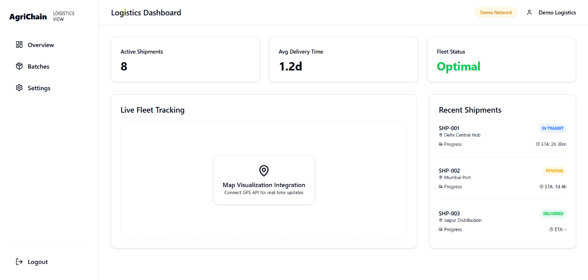
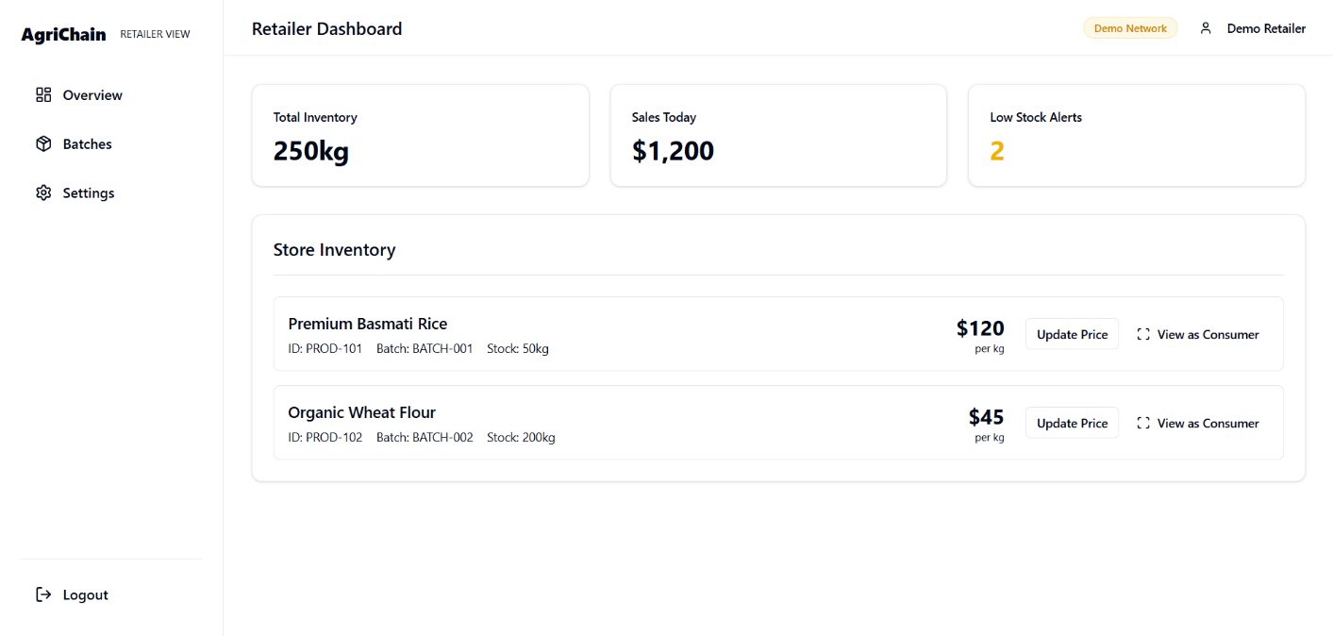
FRONTEND DEVELOPMENT
5.Logistics Dashboard
6.Retailer Dashboard

Slide 14
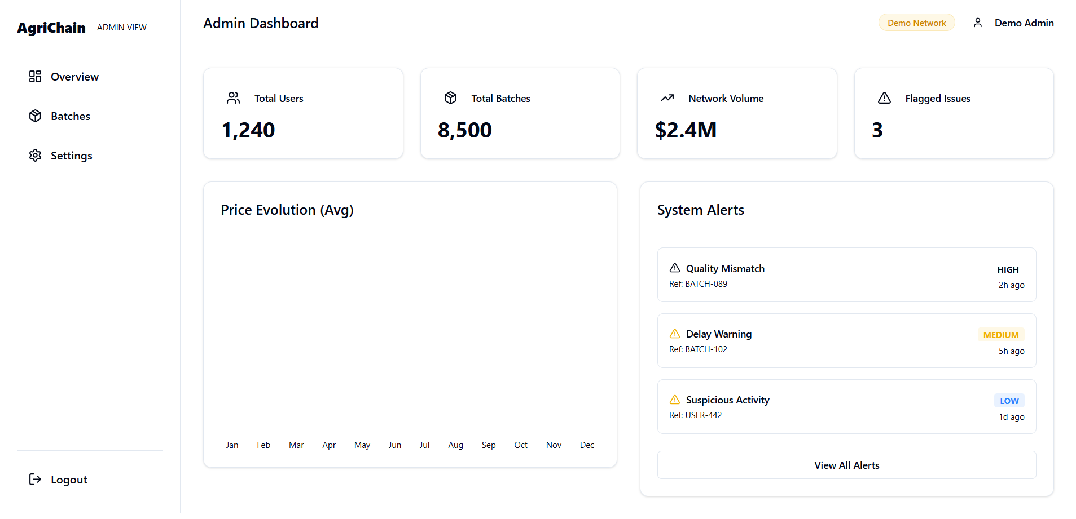
FRONTEND DEVELOPMENT
7.Admin Dashboard

Slide 15
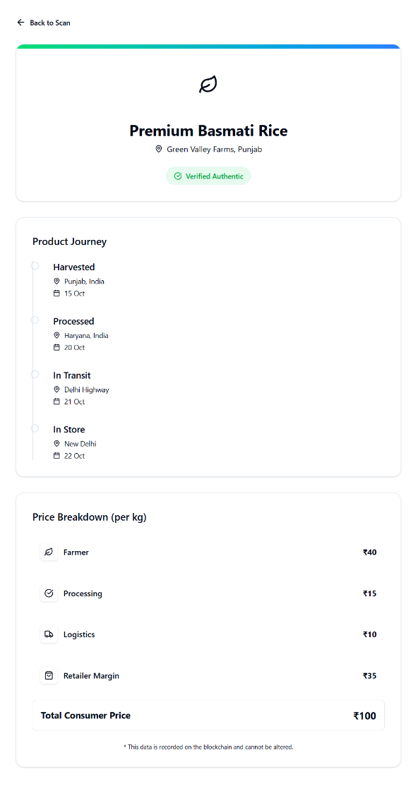
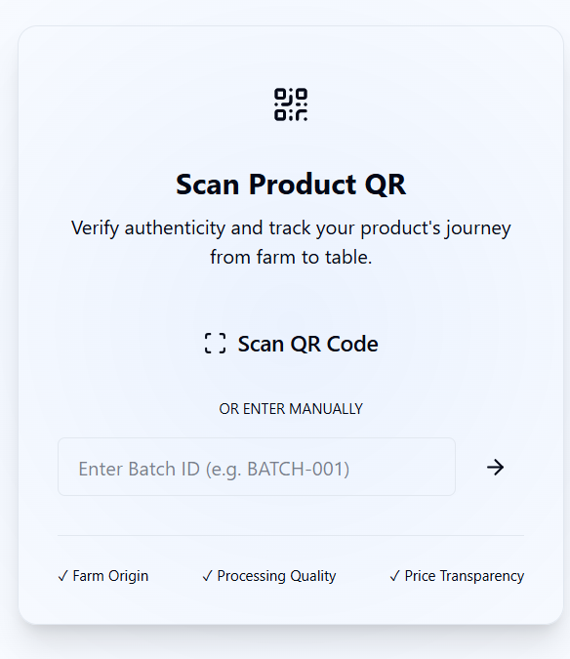
FRONTEND DEVELOPMENT
8.User Scanner
9.User Dashboard

Slide 16
References
Chandan, A., John, M., & Potdar, V. (2023). Achieving UN SDGs in Food Supply Chain Using Blockchain Technology. Sustainability, 15(3), 2109.
Van Niekerk, M. (2024). From source to stomach: How blockchain tracks food across the supply chain and saves lives. World Economic Forum.
Crawford, E. (2018). From 7 days to 2 seconds: Blockchain can help speed trace-back, improve food safety & reduce waste. FoodNavigator-USA.
Thomasson, E. (2019). Carrefour says blockchain tracking boosting sales of some products. Reuters.
Farmonaut. (2023). Blockchain in Agriculture: Unlock Hidden Supply Chain Secrets. Farmonaut Blogs.
AGDAILY. (2024). The Use of Blockchain in Enhancing the Lives of Small Farmers.

Slide 17
References
Tian, F. (2017). A supply chain traceability system for food safety based on HACCP, blockchain & IoT.
Galvez, J. F., Mejuto, J. C., & Simal-Gandara, J. (2018). Future challenges on the use of blockchain for food traceability.
Demestichas, K. et al. (2020). Blockchain in agriculture: Applications and challenges.
Hyperledger Foundation. (Tech docs). Hyperledger Fabric: Architecture and concepts.
Ethereum Foundation. (Tech docs). Smart contracts and Solidity developer docs.
IBM Food Trust. (Case materials). Blockchain-enabled food traceability implementations.

Slide 18
Thank You…..

